Slide 1

Changing Healthcare Dynamics
“Emerging Trends & Cost Shifting Factors ”
Ashraf Al Azzouni
Managing Director
RGA Reinsurance Company Middle East Limited

Slide 2
Agenda
Key Causative Factors
The Future Ahead?

Slide 3
Key Causative Factors
Digital Health
Rising Non Communicable Disease
Ageing Population
Artificial Intelligence
BIG Data
Advancement in Medical Innovations
TeleHealth
Genomics
Private Equity in Health
Digital Health; AI; TeleHealth and Genomics has enabled better access; improved accuracy of diagnosis and treatment, and affordability
Rising NCD; Ageing Population; Innovations in Medicine and PE in Health continues to add to the rising expense in HealthCare
Availability of Data, but effective Non Utilization continues to be an issue.

Slide 4
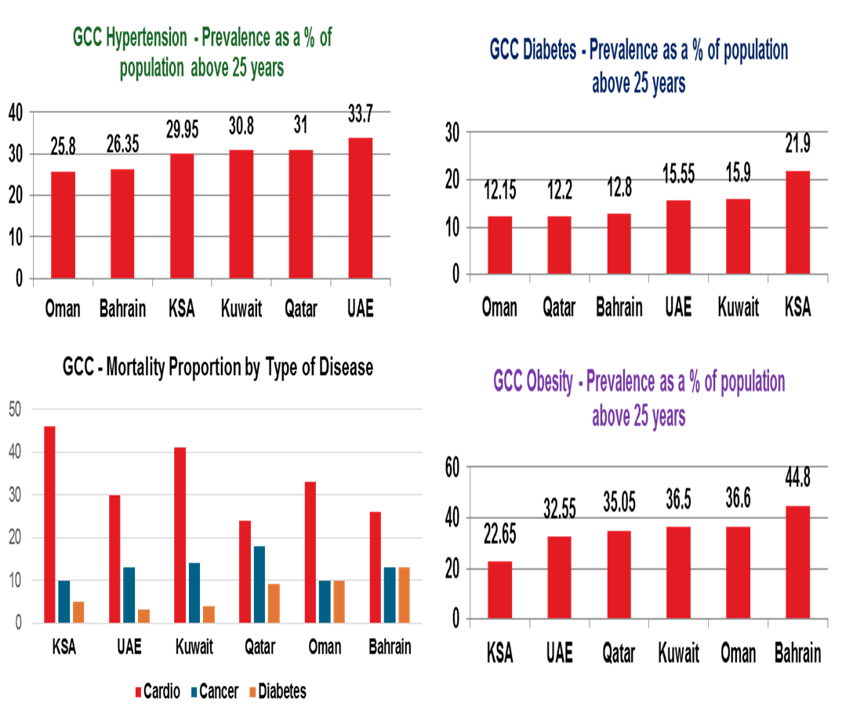
Rising NCD

Slide 5
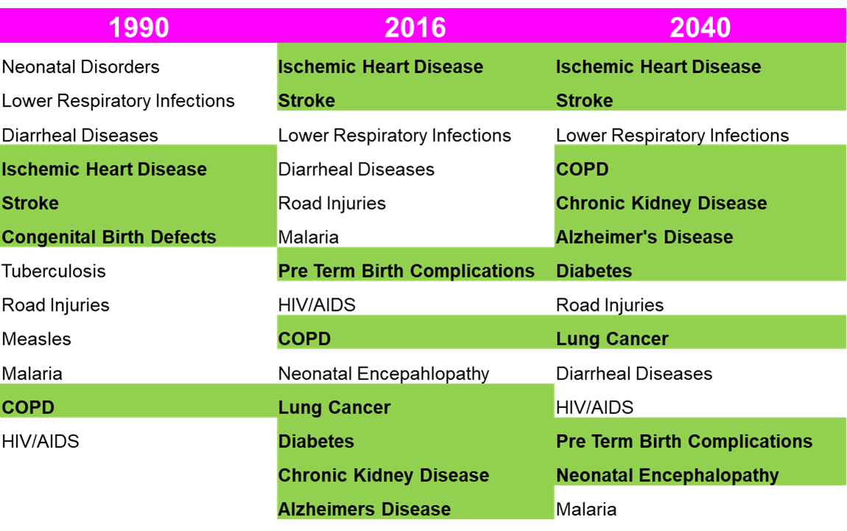
Leading Causes of Early Death - NCD
Increasing mortality from a preventable Non Communicable Diseases (NCD)
Projections do not look good either
Cardiovascular diseases cause 45% of early deaths in the Gulf region
There are some 36.8 million diabetics in the MENA region
The GCC states are forecast to see a sharp 150-200%
The obesity rate for GCC nationals stands at an average of 40%, which is one of the highest in the world .
Mortality rate in GCC from NCDs is one of the highest in the world.
Life Expectancy in GCC is 77 years, but healthy life expectancy was only 65 years. This means on average 10 years of life were spent in poor health – HUGE Burden

Slide 6
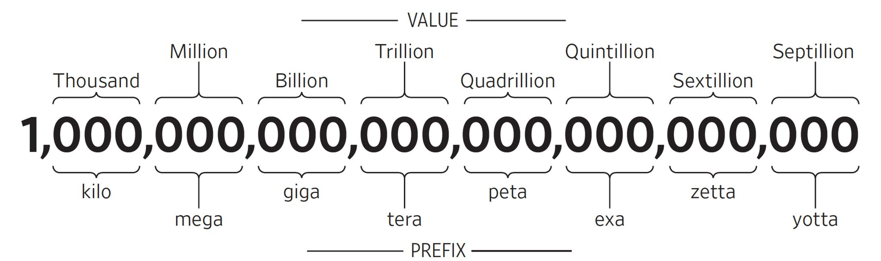
BIG Data – Growth in HealthCare Data
Datacenters Globally only has space for 980 Exabytes
Sources of Health Data: Claims; Provider; Demographics; Wellness; MHealth; Genomic tests; Clinical
HUGE Data accumulation
Data Management Strategies to be adopted rapidly due to lack of available space
Actionable insights required for more efficient strategies for Growth; Competitiveness and Staying Ahead
2020
2314 Exabytes
2013
153 Exabytes
1 Exabyte = 1 billion GB
Source: Stanford Medicine & CISCO Global Cloud Index

Slide 7
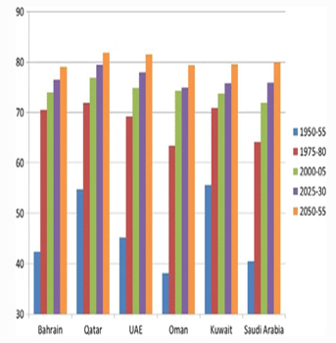
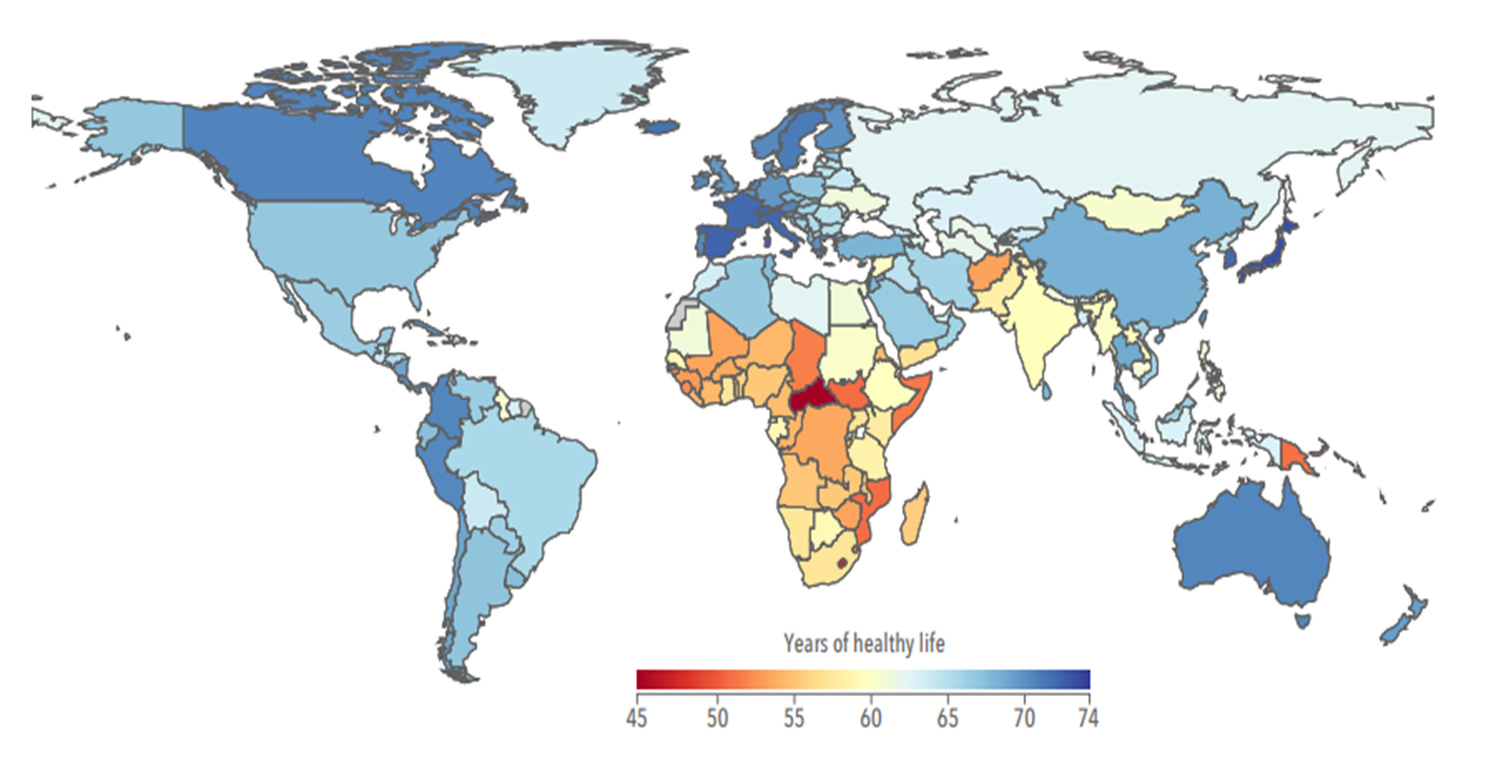
Projected and Actual Average Life Expectancy
Projected = 77 Healthy Actual = 65
Average 10 years of life were spent in poor health

Slide 8
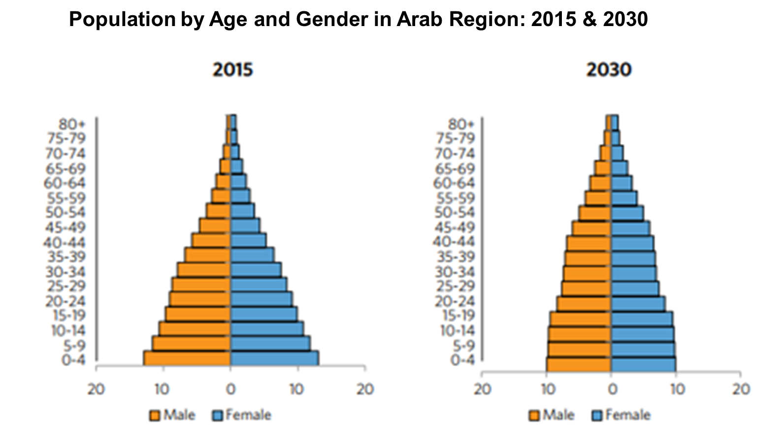
Ageing Population and its Burden of Illness

Slide 9
AI in Health and its Impact
Clinical Decision Support;
Symptom Analyzer
Radiology
Workflows
Predictive Modelling Risk Stratification
Virtual Assistants
Mobile Apps
Precision Medicine
Clinical Trials
Matching Profiles
Impact
Efficient Administrative workflow
Fraud Detection
Reduce Dosage Error
Connected Machines
Accuracy of Diagnosis
Remote Healthcare Delivery
Chronic Disease Management
Robotic Surgeries
Virtual Nursing Assistants

Slide 10
E-world - Larger Markets, Extended reach for Healthcare
E-delivery of services
  Remote diagnostics, specialist consultations, even remote surgery!
  Remote monitoring of chronic conditions
  Tele triage
  Tele primary care consults
  Information, appointments, test results, prescriptions, referrals
Electronic health records
E-markets and e-purchasing

Slide 11
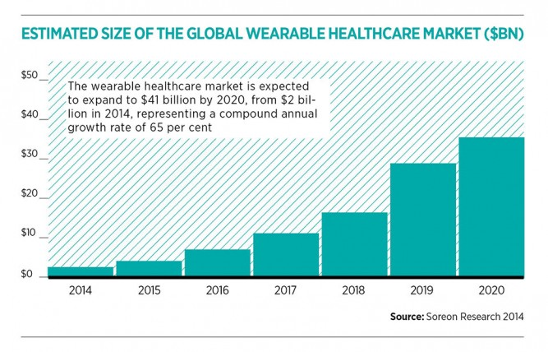
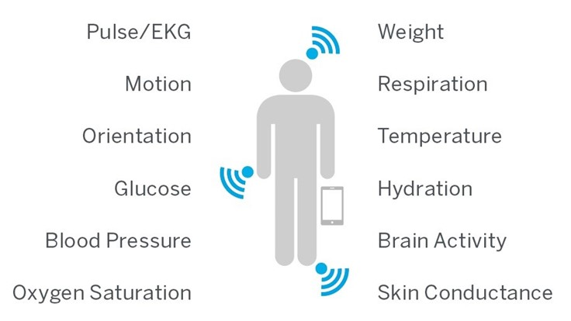
Wearables

Slide 12
Advancement in Medical Innovations
Digital contact lens patented by Google aims to change the course of diabetes management by measuring blood glucose levels from tears | Smartphones being used as biosensors and wearable devices enabling patients to measure almost any health parameter - better health management.
The intelligent surgical knife (iKnife) detect whether the tissue is malignant real-time during surgery | There are about a thousand daVinci surgical robots around the world. Medical schools have started to teach skills to future surgeons which are needed to control the robot instead of manually performing the operation.
Nanoswimmer - micro-sized microbots – smaller than a millimeter – robots that literally swim through your bodily fluids and could be used to deliver drugs | Cancer Treatment – Better cure rates, but with cost of full course ranging from $ 100,000 to $ 2 Million !
.

Slide 13
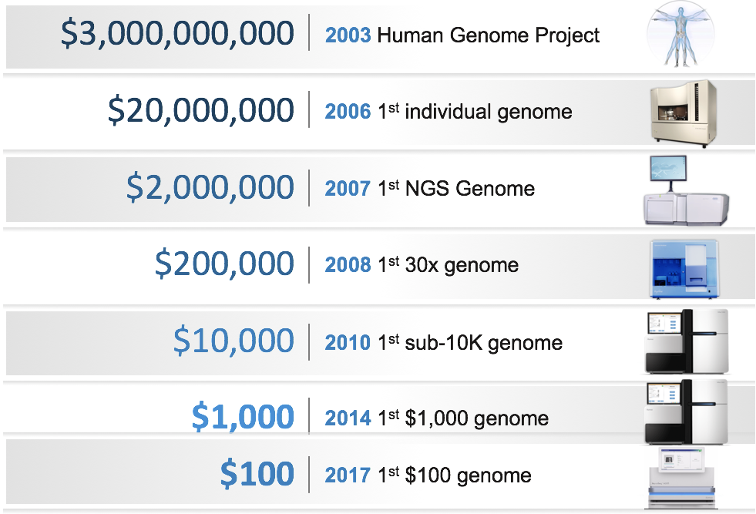
Genomics

Slide 14
The Future Ahead

Slide 15

Any Reforms without
Consumer Engagement
will not have the
desired Results

Slide 16

The future of health insurance is data rich

Slide 17

The future of health insurance is engaging

Slide 18

The future of health insurance is wellness

Slide 19










The future of health insurance is behavioural change

Slide 20

The future of health insurance is regulated

Slide 21

The future is Artificially Intelligent

Slide 22
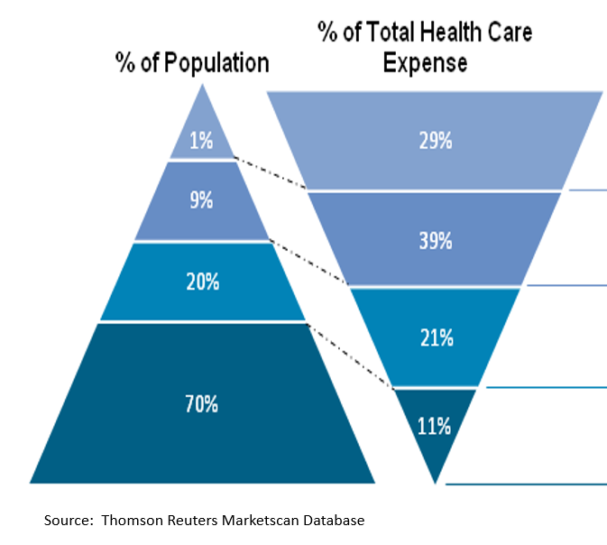
Focus for Change
10% Population that is the cause for 70% Expenses

Slide 23
Initiatives for Change
Participative Customer Engagement
  Behavioral Changes
  Mental Health
  Preventive Care
  Home HealthCare
  Remote HealthCare
Proactive Chronic Disease Management
  Focus: Diabetes/Hypertension/Obesity
  Wellness/Fitness/Lifestyle Changes
  Preventive/Proactive/Measure Outcomes/ Report Improved Health
Fixed DRG (vs. scale driven today) for In Patient and Daycare Treatments
Centralize Electronic Medical Records with Universal Access
Improve Health NOT Profits
Outcomes and Value Driven Providers and TPA

Slide 24
From Reactive to Proactive to Participative

Slide 25
©2019 RGA. All rights reserved.
No part of this publication may be reproduced in any form without the prior permission of RGA.
The information in this publication is for the exclusive, internal use of the recipient and may not be relied upon by any other party other than the recipient and its affiliates, or published, quoted or disseminated to any party other than the recipient without the prior written consent of RGA.

