Slide 1
Legal Framework in respect of Retirement Benefits
in the GCC
Omer Morshed, FIA, FCA

Slide 2
Presentation Flow
Retirement Benefit Framework
State Pension Schemes in the GCC
End of Service Benefits in the GCC
Voluntary Pensions Arrangements

Slide 3
Retirement Benefit Framework

Slide 4
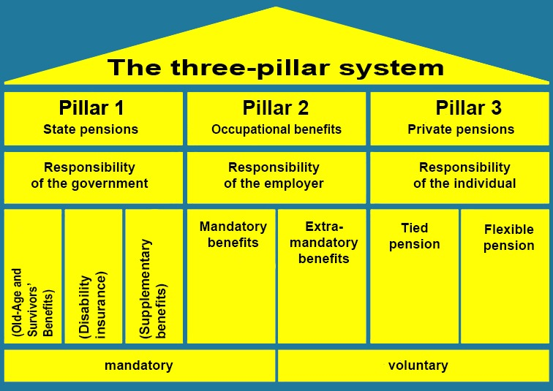
Traditional Old Age Income Framework
Pillar 0
Extremely Poor
Sometimes
Added In

Slide 5
Special Circumstances in GCC Countries
GCC countries differ from other countries in terms of a large proportion of their populations being expatriates.
Proportion of expatriates by country:
KSA 38%
UAE 87%
Kuwait 70%
Oman 44%
Qatar 87%
Bahrain 55%
This impacts the way these countries address the old age problem as the vast majority of expatriates return to their home countries post-retirement.

Slide 6
How The 3 Pillars are Addressed in GCC Countries
Pillar 1
State Pension
Pillar 2
Occupational Schemes
Pillar 3
Private Pensions
Voluntary
Pensions
State
Schemes
Limited to Own Nationals
Varying Degrees of Generosity
Usually contributions by employers and members but guaranteed by state
Nationals Covered by State Schemes
Covered by Labour Laws – very largely lump sum Gratuity (End of Service Benefits) which are defined benefit
Usually non-regulated
Regulations not required due to lack of any taxation on individuals
EOSB
Schemes

Slide 7
Two Distinct Systems
Nationals
Expatriates
Covered by Social Security System
Run by state institutions set up for the purpose
Contributions by employer/member but scheme effectively guaranteed by government
Sometimes multiple institutions in a country dealing with different segments of the population
Benefits tend to be very generous compared to schemes in other countries (including developed ones)
Basic benefit includes a pension payable over time
Not Covered by Social Security System
Employers are required to provide minimum benefits
Cost borne by employers
Basic benefit tends to be a lump sum based on length of service and final salary

Slide 8
State Pension Schemes in GCC
The current pension schemes in the GCC region are Defined Benefits Plans,
with high benefit levels compared to other countries.

Slide 9
Kingdom of Saudi Arabia
Law: Social Insurance Law issued in 1969/ New Law in 2000
Retirement Age: 60 years men/ 55 women (younger for military)
Entitlement criteria: 60 men / 55 women with Paid/Credited 120 months contributions
Any age with 300 months of contribution if no longer covered
Old Age Pension:
Age/Contribution Term: Insured Person: 9% of gross, Employer: 9% of gross, Govt: operating deficit
Benefit: 2.5% of average earnings for each year of contribution (max 100%)
Disability Pension: Yes
Survivor Pension: Eligible survivors include the widow(er); a dependent son younger than
age 21 (age 26 if a full-time student); a dependent, unmarried daughter;
and siblings, parents, grandparents, and grandchildren in certain circumstances.

Slide 10
United Arab Emirates
Law: Social Insurance Law issued in 1999 and 2000 in Abu Dhabi
Retirement Age: age 60 years (men) and 55 (women)
Entitlement criteria: retirement age with 15 years service and 20 years service for lower ages
Abu Dhabi retirement age or 25 years of service
Old Age Pension:
Contribution Term: Insured Person: 5% of salary, Employer: 15% of salary, Govt: 2.5%
Contribution Term Abu Dhabi: Insured Person: 5% of salary, Employer: 15% of salary, Govt: 6%
Benefit: 60% of pension + 2% every additional year in excess of 15 years (max 100%)
Benefit Abu Dhabi: 48% of pension + 3.2% every additional year in excess of 15 years (max 80%)
Disability Pension: Yes
Survivor Pension: Eligible survivors include the widow(er); a dependent son younger than
age 21 (age 28 if a full-time student); a dependent, unmarried daughter;
siblings and parents.

Slide 11
Oman
Law: Social Insurance Law issued in 1991
Cover: Civil Service Employees Pension Fund (government employees)
Public Authority for Social Insurance (Private-sector or working in GCC)
Foreign workers, household workers, self employed persons are excluded.
Retirement Age: 60 years men / 55 years women
Old Age Pension:
Contribution Percentage: Insured Person: 7% of salary, Employer: 10.5%, Government: 5.5% of salary
Age/Contribution Term: Men: Age 60 and 180 months paid contributions; Women: Age 55, 120 months
Early pension: Age 45 - 59 years; contributions: men (240 months), women(180)
Benefit: 3% of insured’s average wage in the last 5 years of employment for each year of contribution (max 80%)
Disability Pension: Yes
Survivor Pension: Eligible survivors include the widow(er); a dependent son younger than
age 22 (age 26 if a full-time student); an unmarried daughter;
and siblings and parents.

Slide 12
Qatar
Law: Social Insurance Law issued in 2002
Entitlement: Public, selected private or working in one of the GCC countries, Self-employed persons, household and foreign workers are excluded.
Retirement Age: 60 years men / 55 years women
Old Age Pension:
Contribution Percentage: Insured Person: 5% of gross, Employer: 10% of basic, Government: any deficit
Age/Contribution Term: Men: Age 60 or Age 40 with 15 years of contribution
Early pension: Age 45 - 59 years; contributions: men (240 months), women(180)
Benefit: 5% of wage for each year of contribution (max 100%)
Early Pension: The above pension will reduce by 2% for each year before retirement age
Disability Pension: Yes
Survivor Pension: Eligible survivors include the widow(er); a dependent son younger than
age 21 (age 26 if a full-time student); an unmarried daughter;
and siblings and parents.

Slide 13
Kuwait
Law: Social Insurance Law issued in 1976 and supplementary system in 1992
Entitlement: Basic system: Public, Private and oil sector, self employed and military personnel. Supplementary system: monthly earning greater than 1,250 dinars or those with sources of earnings not covered by the basic system.
Retirement Age: 55 years men and 50 years women
Old Age Pension: Basic system
Contribution Percentage: Insured Person: 5% of earnings, Employer: 10%, Government: 10% of earnings
Age/Contribution Term: Age 50 with atleast 15 years of contributions for both men and Women
Benefit: 65% of insured last monthly earnings plus 2% for each year of contributions exceeding 15 years, (max 95%)
Disability Pension: yes
Survivor Pension: Eligible survivors include the widow; a dependent son younger than
age 26 (age 28 if a full-time student); an unmarried daughter;
and siblings, parents and son’s children.

Slide 14
Bahrain
Law: Social Insurance Law issued in 1976
Entitlement: Private-sector or working in one of the GCC countries, voluntary for Bahraini citizens working abroad.
Foreign workers, household workers are excluded.
Retirement Age: 60 years men / 55 years women with 10 years of contributions
Old Age Pension:
Contribution Percentage: Insured Person: 6% of earning, Employer: 9% of earning, Government: Nil
Age/Contribution Term: Men: Age 60 and 180 months paid contributions; Women: Age 55, 120 months
Early pension: Age 45 - 59 years; contributions: men (240 months), women(180)
Benefit: 2% of insured’s average wage in the last 2 years of employment for each year of contribution (max 80% plus an additional 10%)
Early retirement Pension: at any age with 20 years of contributions (men) and 15 years (women)
max 20% reduction if retirement age is less than 45 years
Disability Pension: Yes
Survivor Pension: Eligible survivors include the widow(er); a dependent son younger than
age 22 (age 26 if a full-time student); an unmarried daughter;
and siblings and parents.

Slide 15
Generous Benefit Structures
Low Retirement Ages
50 to 60 years for males compared to 65+ in Europe
Very high rate of accrual of benefits
2% to 2.5% compared to 0.89% in UK and 1% in Germany
Pensions capped at a very high level
100% in some cases
Pensions payable from younger ages without any actuarial reduction
Generous survivorship pensions
Children included to fairly high ages – unmarried daughters; sons to 21 or 26 if still going through education. Even grandchildren if their father is not alive.

Slide 16
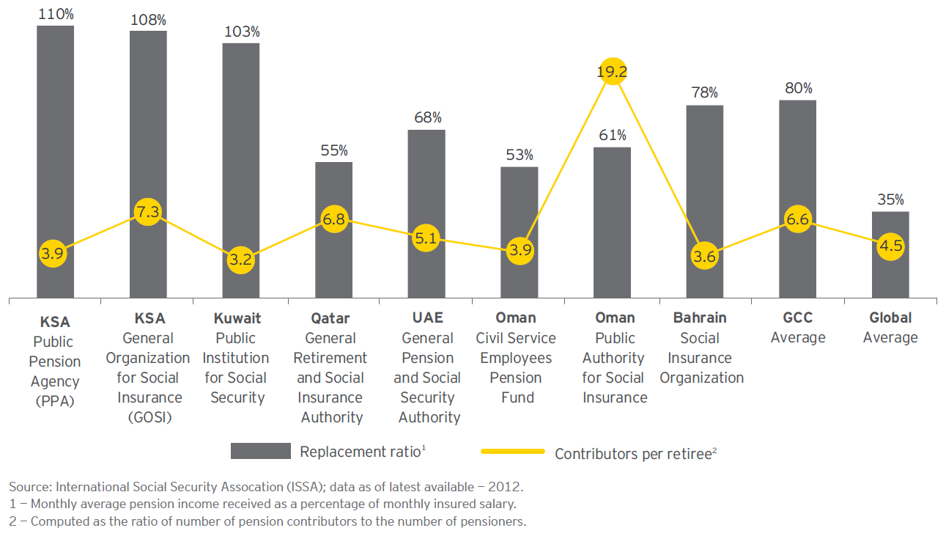
GCC Pension Indicators

Slide 17
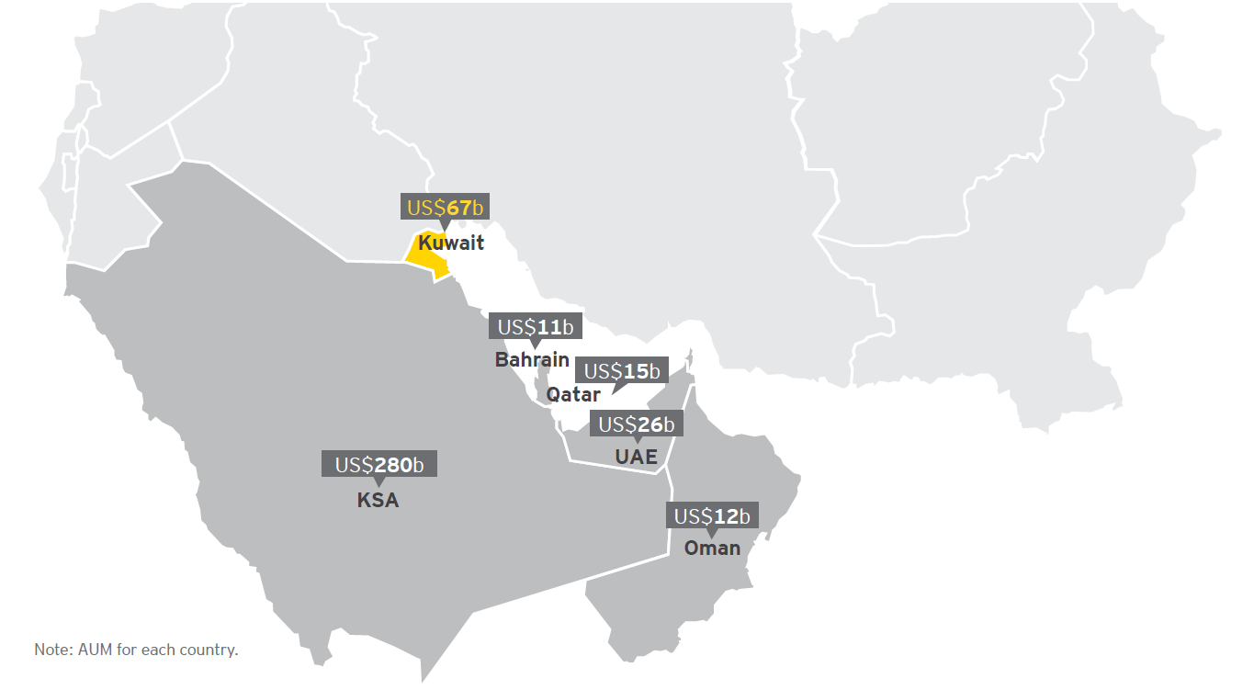
Inadequate Contributions and Funding
Contributions from employers and members not adequate to meet liabilities
Funding of Past Service Cost Inadequate
Working for the time being due to the ratio of active members to beneficiaries being very high
Source: World Development Indicators, World Bank - (2014)

Slide 18
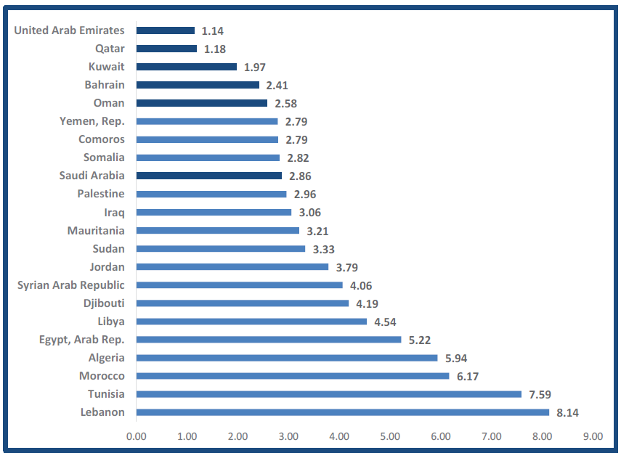
Young Populations
Very low proportion of retired persons
Chart shows proportion of population over age 65
Source: World Development Indicators, World Bank - (2014)

Slide 19
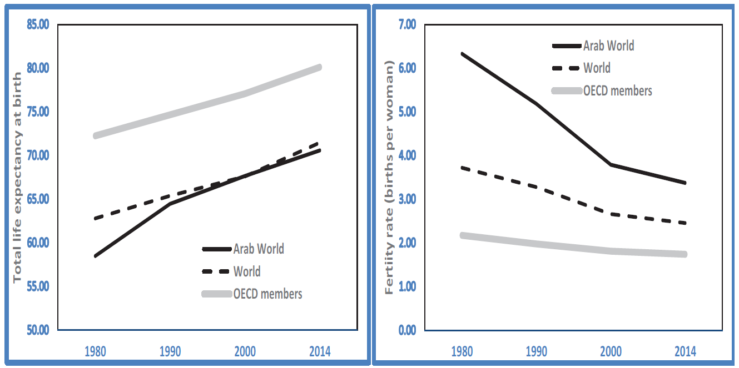
But Ageing Fast
Life Expectancy & Fertility Rate, 1980-2014
Source: World Development Indicators, World Bank

Slide 20
Recommendations
Rationalize Scheme Design
Reduce benefit accrual factors
Raise Retirement Ages (to at least 60 – or actuarially reduce pensions)
Increase contributions
Improve collection of statistics and monitoring
Possible grants from state to funds to increase funding ratio of schemes

Slide 21
End of Service Scheme Benefit Rules in GCC
The current EOS schemes in the GCC region are Defined Benefits Plans,
which means that the benefit is calculated according to the formula.

Slide 22
Kingdom of Saudi Arabia
Retirement Age
65 years
EOSB Payable Proportion
½ month’s salary for each year of service up to five years and then one month salary for each year of service thereafter.
Exit Scenarios
Resignation
In case of the employee resigning from a contract of unspecified length, the benefits will be reduced by two-third in case of service being more than 2 years and less than 5 years, by one-third in case of service being more than 5 years and less than 10 years and the full terminal benefit is paid in case of service being more than 10 years.
Termination
In case of the employee being terminated from the contract, 100% of the benefits will be payable to the employee, except when for misconduct, disobedience or violation of any existing rules and regulations.
End of Contract
100% of the benefits will be paid upon leaving the service on completion of contract term and with proper notice period

Slide 23
United Arab Emirates
Retirement Age
60 years
EOSB Payable Proportion
21 day’s basic for each year of service up to five years and then one month basic for each year of service thereafter subject to a maximum of 24 months gross salary. The actual payout is based on the exit scenario detailed below.
Exit Scenarios
Resignation
In case of the employee resigning from a contract of unspecified length, the benefits will be reduced by two-third in case of service being more than 1 year and less than 3 years, by one-third in case of service being more than 3 years and less than 5 years and the full terminal
benefit is paid in case of service being more than 5 years. No gratuity is
paid if the employee resigns in the first year of service.
Termination
In case of the employee being terminated from the contract, 100% of the
entitlement will be paid to the employees, except when for misconduct,
disobedience or violation of any existing rules and regulations.

Slide 24
Bahrain
Retirement Age
60 years (Extendable)
EOSB Payable Proportion
Half month’s wage for each of the first three years of employment and one month’s wage for each of the following years in service.
A worker shall be entitled to receive his leaving indemnity for fractions of the year in proportion to the period spent in the employer’s service.
Exit Scenarios
Retirement upon the attainment of the normal retirement age
Death in service of the employer
Resignation from service
Termination of his/her service by the Employer, other than for misconduct,
negligence or incompetence

Slide 25
Qatar
Retirement Age
60 years (Extendable)
EOSB Payable Proportion
Leaving indemnity calculated at the rate of 21 Days last drawn basic salary for each year of Service.
Exit Scenarios
Retirement upon the attainment of the normal retirement age
Death in service of the employer
Resignation from service
Termination of his/her service by the Employer, other than for misconduct, negligence or incompetence

Slide 26
Kuwait
Retirement Age
60 years
EOSB Payable Proportion
The worker shall be entitles to a 15 days remuneration for each of the first 5 years of service and one month remuneration for every year thereafter (Subject to maximum benefit of 18 months’ salaries).
For Contracts of unspecified length, the benefit will be one third in case of service being more than 2 years and less than 5 years, two third in case of service being more than 5 years and less than 10 years and the full terminal benefit is paid in case of service being more than 10 years.
Exit Scenarios
Retirement upon the attainment of the normal retirement age
Death in service of the employer
Resignation from service
Termination of his/her service by the Employer, other than for misconduct,
negligence or incompetence

Slide 27
Oman
Retirement Age
60 years (Extendable)
EOSB Payable Proportion
½ month’s salary for each year of service up to five years and then one month salary for each year of service thereafter. Salary for EOSB calculation is the last drawn basic salary.
Exit Scenarios
Retirement upon the attainment of the normal retirement age
Death in service of the employer
Resignation from service
Termination of his/her service by the Employer, other than for misconduct, negligence or incompetence

Slide 28
Summary of Standard Structure
General target benefit – 1 month salary for each year of service
Variations
Recently DIFC has introduced a regulations for shifting the EOSB from DB to DC benefits and regularly funding the scheme for service after the introduction of the scheme from January 2020
An Abu Dhabi public sector entity a few years ago merged EOSB with monthly emoluments – thereby doing away with EOSB
Accounting
Strictly employer liability and period costs should be measured and disclosed in line with International Accounting Standard 19
However this is not uniformly followed - strictly imposed by most audit firms in KSA but not in other countries
KSA EOSB liabilities increased by 20% when IAS 19 adopted for first time
Almost all schemes are unfunded – liability carried in employer entity balance sheets

Slide 29
Challenges with Current Structure
These are End of Service Benefits and not Retirement Benefits
Benefit paid out (and usually spent) on change of jobs, return to home country, etc
Hence often very small amounts received on actual retirement
This is, however, an issue with all lump sum employer controlled schemes
Defined benefit schemes
Therefore cost of salary increases need to be borne by employer
Lack of Funding
There are no separate assets to pay to the outgoing employees and employer has to use their working capital to pay the EOSB amounts
Benefits at Risk if employer entity becomes insolvent
No back up fund to pay even partial benefits in such an eventuality

Slide 30
Recommendations
Possibly switch to Defined Contribution Schemes with mandatory funding
Life insurance and asset management companies can be licensed to offer US 401K type schemes with controlled charge structure and regulated investment policies
Can offer continuity on persons switching jobs within a country or even within the GCC
While the existing EOSB structure continues need to ensure adherence to IFRS framework (to IAS 19)

Slide 31
Voluntary Arrangements
.

Slide 32
Voluntary Private Pensions
There is no formal system like the US 401K scheme or voluntary pensions in other countries
No need for regulations as individual income is not taxed in the GCC
A number of life insurance companies market long term life insurance savings products as retirement plans – sometimes with an annuity option at retirement.
Tend to have very high commissions and very low values (although IA has recently issued regulations to limit these the commissions will still be very high)
Challenges remain for true pension products and annuities due to the transient nature of the majority of the population.

Slide 33
Q & A

