Slide 1
Role of insurance in provisioning for Retirement
Ashraf Al Azzouni
Managing Director
RGA Reinsurance Company Middle East Limited
October 16, 2019

Slide 2
3 forms that we will discuss today
Pension Completion
Mortality Risk
Annuity – regular, enhanced, impaired & Longevity
Long term care – TPD on ADL basis ’ –
Save for retirement throughout our working lives using either:
A personal pension plan with an insurance or pensions company or via an employer’s company pension scheme.
Lump sum accrued by retirement age
This is a form under which the insured (individual / member) is protected for Life Sum Insured equal to a Pension targeted amount, decreasing or flat
Annuity – Pay me a lump sum and I promise to pay you back some money each month until you die. If you live for a long time you win, if you live for a short time I win as I don’t repay any of the ‘balance’.
Enhanced Annuity – Same idea as an annuity except that I underwrite you to see if there is anything impacting on your normal life expectancy. If you are ill you will have a shorter life expectancy and so I will pay you more as I know I’ll be paying it out for a shorter time.
Longevity
This is life insurance:
Rules are reversed
Expertise is the same
One of the major risks of surviving long but being disabled;
In this scenario:
regular premium is paid until retirement; or, single premium is paid upon retirement –
for the insurer to provide stream of payment when the person is incapacitated to take care of nursing/other needs

Slide 3
Pension Completion

Slide 4
Pension Completion – Level Term
Protection set at EOS potential amount
Assumptions
Khalid just signed up for a new job in UAE
His salary is AED 25k / month
He plans to work for 10 years
He targets to leave with > AED 300k end of the 10 years + potential regular savings
Salary indexation / COLA is 5%
Targeted saving amount accordingly is AED 314k+
Life insurance protection AED 315k flat, 10 years cover
Premium can be leveled or annual

Slide 5
Pension Completion – Decreasing Term
Protection set at EOS potential amount during year 1 only
Assumptions
Khalid just signed up for a new job in UAE
His salary is AED 25k / month
He plans to work for 10 years
He targets to leave with > AED 300k end of the 10 years + potential regular savings
Salary indexation / COLA is 5%
Targeted saving amount accordingly is AED 314k+
Life insurance protection is set at AED 315k on day 1 and decreases over time to become ZERO end of policy term
Premium can be leveled or annual

Slide 6
Characteristics of pension completion benefit
1
Simple, easy to understand and plan
2
Can be sold as a Individual Cover, Group cover compulsory or voluntary, employer paid or voluntary
3
Doesn’t contradict with existing Group Life and can be sold under Free Cover Limits type of underwriting approach relative to group size
4
Under individual can be sold with a simplified underwriting process to achieve >70% Straight Through Processing (STP)
5
Application and/or UW can be processed easily with RGA U/W apps like AURA, Underwriting Pal

Slide 7
Annuities – UK Market View

Slide 8
UK Pension Annuity Market
Pension Annuity
Market
Enhanced
Impaired
Enhanced Market: approx. 40% of annuitants would qualify for an enhanced annuity.
Impaired Market: annuitants with severe medical conditions.

Slide 9
Definitions - Impaired v Enhanced
Enhanced
Impaired
Simple lifestyle factors, eg smoking
High level of automation
Small additions
Historically simple underwriting
Now becoming more sophisticated
Serious cases eg cancer
High enhancements
Medical evidence
Human intervention
Historically slow and costly

Slide 10
What is this market all about
What created the UK Market?
Game changers have been :
Simple Portal Application Process & Common Quote Request Form
Increased supply
Increased demand from baby boomers
New players entering the market
Marketing activity
Press / Consumer / Adviser / Regulator / Government demand
UK Budget 2014
For IFAs this is impossible to ignore and represents best advice for an annuity deal
Regulators, Press and Government all see this as the best deal for the customer
Notes:
Quickly describe the process for buying & the way that automated underwriting is speeding yup the process and leading to more guaranteed decisions.

Slide 11
Underwriting Process
RGA provides the tools needed to make a decision:
Portal friendly on-line system
More comprehensive tool for Life Office Underwriters
On-line Manual
Access and support of local underwriters
24 Hour CMO Access
Less than 5% of cases to be referred to RGA
Almost all turned round within 24 hours

Slide 12
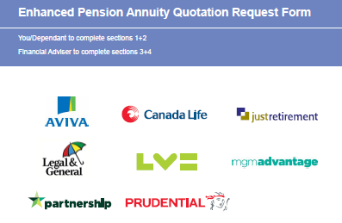
The Common Application Form and Medical Evidence
Personal Information
Smoking Information
Specific Questionnaires for:
Heart Conditions
Diabetes
Cancer, leukaemia etc
Stroke
Respiratory / Lung disease
Multiple Sclerosis
Neurological Disease
Activities of Daily Living
General Questionnaire for up to 3 more conditions
No medical evidence requested, except post issuance disclosure checking

Slide 13
Automated Annuity U/W System (Portal AURA)
Accessed by Brokers or Providers via portals
RGA’s black box of rules sits on our servers
Provides guaranteed decisions in 70 - 90% of cases
Provides indicative quotes for remaining % of cases
Automation now the most popular route

Slide 14
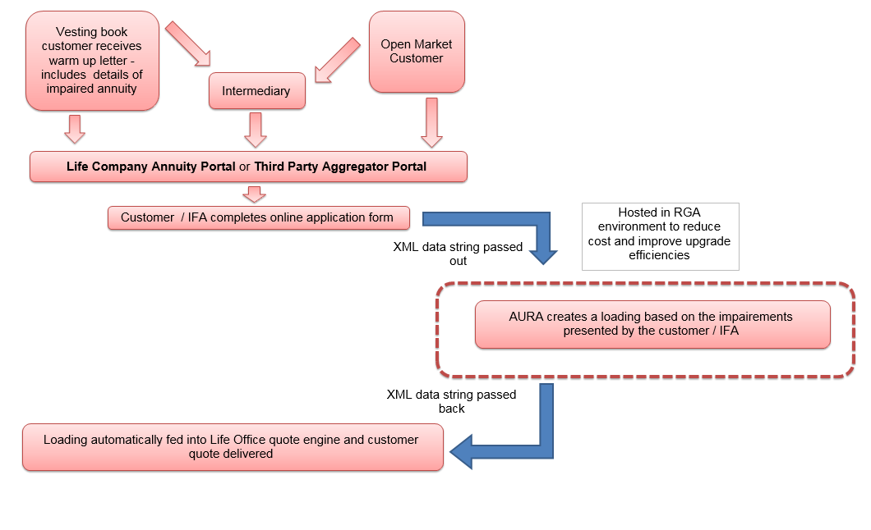
Case study – typical online process

Slide 15
What kind of people are buying enhanced annuities?
Most Common Primary Conditions
Prostate Cancer 1-2%
Other
Smoker 20-25%
High Blood Pressure
15-20%
Heart Attack 8-11%
Diabetic 10-18%
Angio 5-8%

Slide 16
Underwriting and Pricing Impaired Annuities

Slide 17
Mortality Assumptions Needed
Current/Base Mortality Rates
Impairment loadings
Future change in mortality rates
Notes:
Concentrating on future change – this is where the big questions are.
Improvements generally underestimated in the past.... And there are a range of views our there....
Pessimists suggest life expectancy might level off or decline due to obesity, poor diet, global warming etc. – (Olshansky)
Optimists suggest no natural limit to human life – (Vaupel)
Indeed interest in longevity improvements largely due to the low interest rate environment we now live in.

Slide 18
Other Assumptions Needed
Financials
Interest Rates, yield curves
Inflation
Expenses
Profit, Cost of Capital, Tax
For pension scheme buyout, demographic assumptions
Proportion married
Age difference between member and dependant
Best estimates, Prudent assumptions, Stress Scenarios, (Statistical Distributions)

Slide 19
Base table construction
“Healthy” Base table
Smoker Disaggregation
Socioeconomic Adjustments
Use CMI Tables
Blend to get light mortality
Adjust for ill-health
Relative risk factors
Prevalence at older ages and for high SE groups
Explicit allowance for over disclosure, cessation, otherwise healthy
Either via postcode models or purchase price adjustments
Notes:
10 mins

Slide 20
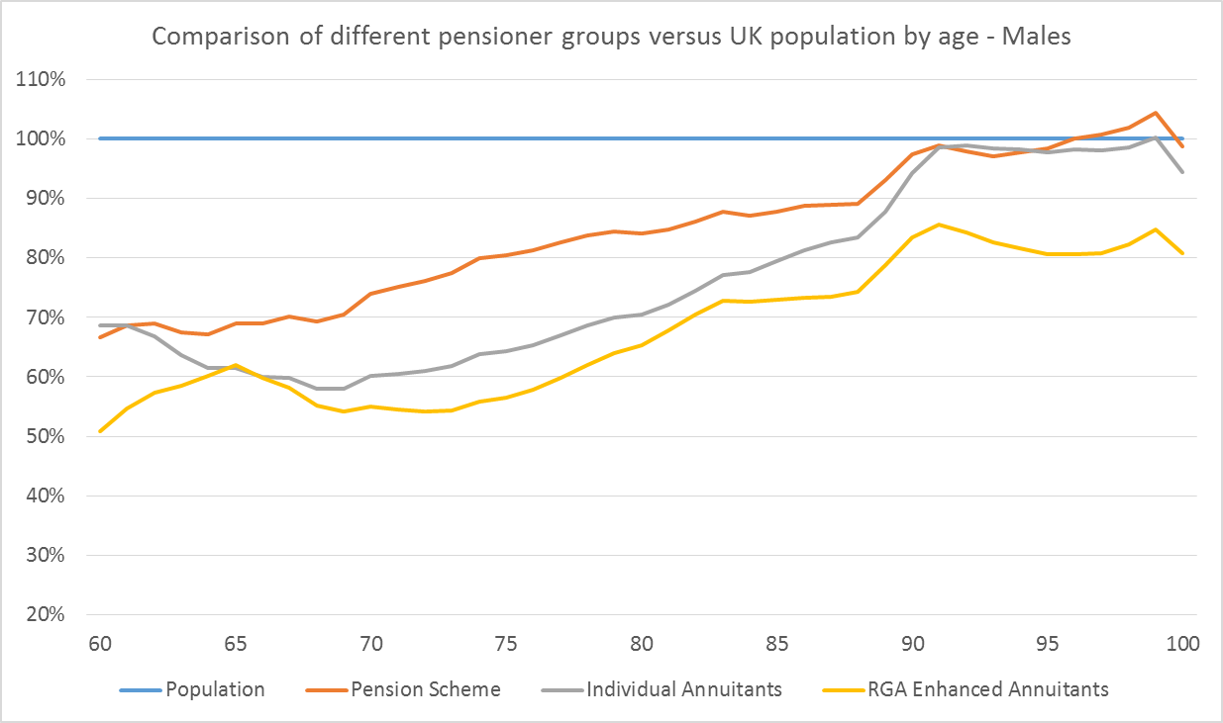
Healthy base table
Notes:
Graph shows male mortality for different pensioner subgroups vs general population
Orange line is a UK standard table representing occupational pension scheme members (no underwriting – will include some ill health on retirement)
Grey line is a UK standard table representing individual annuity business sold by insurers – these are also no underwritten but generally come from higher socioeconomic classes so hence why lower
Yellow line is the RGA EA basis – expect similar SEG to individual business but represents healthy lives – it is also aggregate smoker so the non-smoker version would be lower.

Slide 21
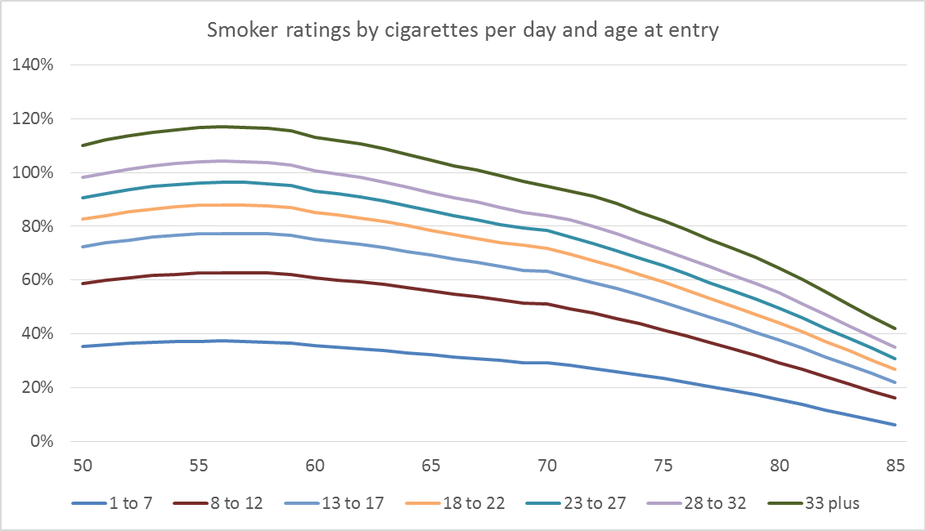
Smoker loadings
Notes:
This shows the typical loadings we apply to the basis by age and cigarettes per day. The range in rating is material and was derived from data where we had mortality information and CPD.

Slide 22
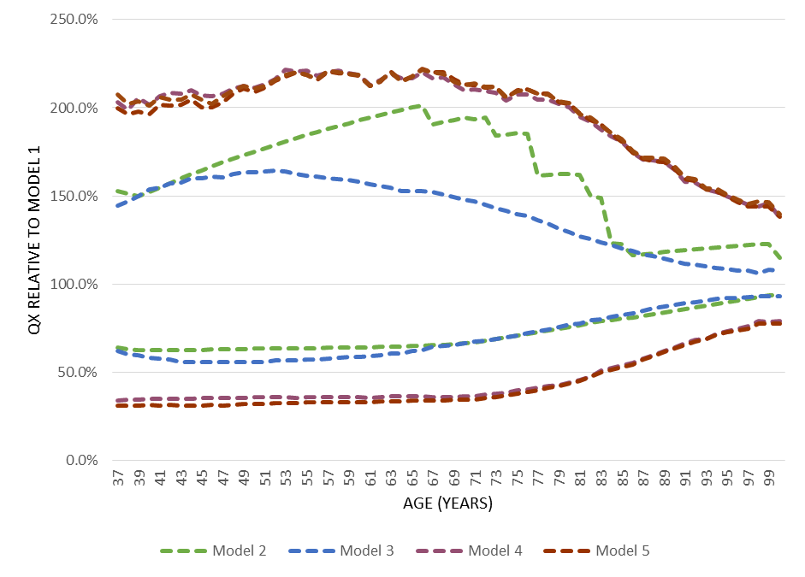
Impact of socioeconomic status
Impact of health and/or socioeconomic status on mortality
10th and 90th percentiles of predicted mortality rates for Models 2-5 relative to Model 1 by age
Model No. | Variables included
1 | Gender only
2 | Gender & smoker
3 | Gender, socioeconomic & marital status
4 | Health details, underwriting classification & smoker status
5 | M3 + M4
RGA UK - Much more details on this are available
Notes:
Work based on a dataset that contains:
3.15m patient records – over age of 32
324k deaths
Subset used to control date of entry into the cohort and observe only those who had been registered with a practice for at least 5yrs
1.35m records
168k detahs
All records anonymized (DoBs, names, postcodes etc. NOT provided)
Strict controls on the use of the data, who has use and what we can publish
Socioeconomic info available via indices mapped at source.
Separate models created from the data (shown)
Enables us to see the impact of including different information and risk factors (go thru the models)
M4 includes an allocation of each life to a S/R/D group depending on the read codes in their patient records at entry point to the cohort.
See that widest differentials are for M4 and M5
Cannot see much difference between M4 and M5 in this graph

Slide 23
Underwriting Loading Specifics

Slide 24
Rating Methodologies
Standard Metrics are used…
Percentage Extra mortality
Flat per Mille Extra
Derived to be actuarially equivalent at point of sale to true risk profile with different conditions evolving differently relative to base mortality:
Ever increasing (e.g. degenerative neurological conditions)
Temporary Increase (e.g. most cancers)
Persistent differences (e.g. smoking)
Correct Loading at point of sale will probably not be the correct loading for lifetime of the policy

Slide 25
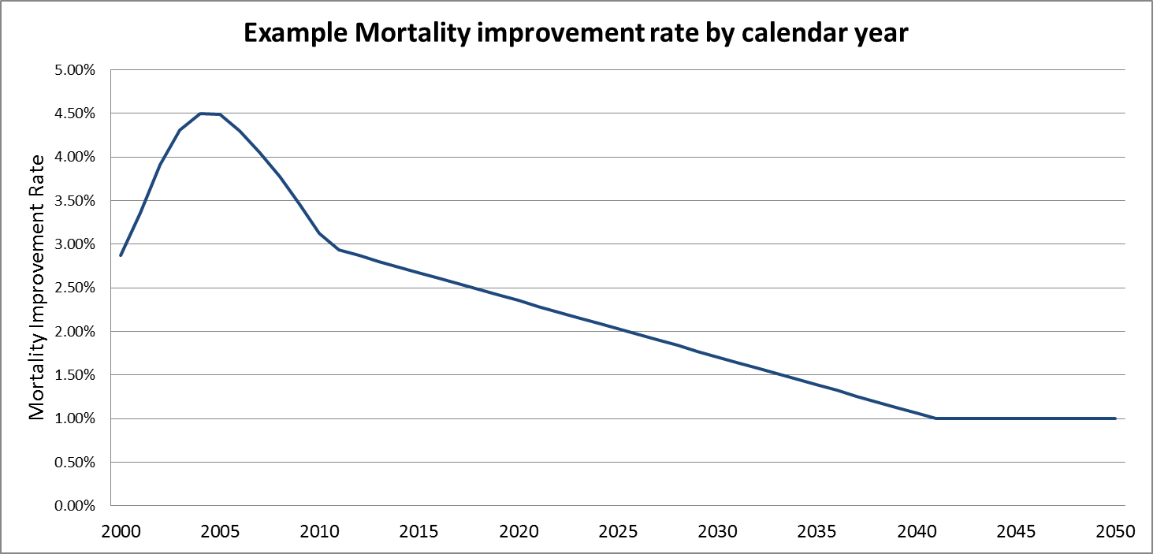
Modelling Mortality Improvements
Actual trends
Initial assumption
Convergence period
Long term assumption
Notes:
This is a basic representation of the structure of the assumption – this is a common approach in the UK and other markets such as the US and Canada.
Initial rates – fairly straightforward – see next slide
LTR – less straightforward – need to anticipate what might happen in the long term
Convergence period – how join the two together

Slide 26
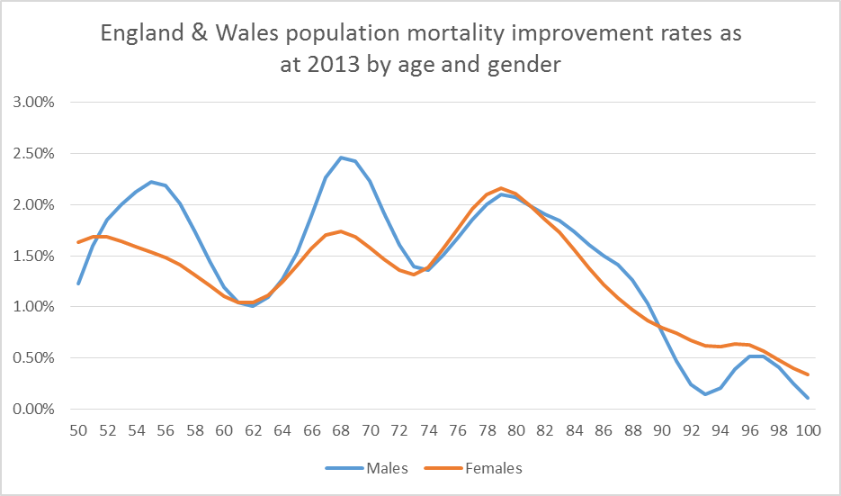
Current Levels of Mortality Improvement Rates (2013)
Source : ONS Data, RGA analysis
Notes:
It’s important to know where we start from, before looking to the future.
Here are the smoothed ‘current’ rates of improvement, by age. Estimates are those made by CMI, the research body of the actuarial profession.
Note the distinct peaks and troughs.

Slide 27
Longevity Risk

Slide 28
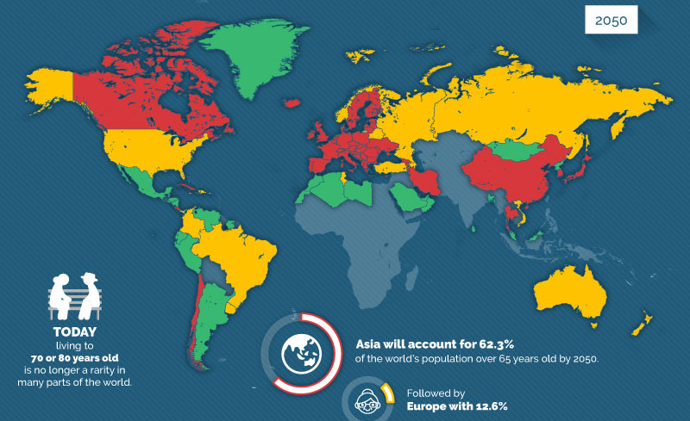
Rapidly Aging Population – A Timebomb ?
In Year 2012 11% of world’s 6.9 bn were over 60 years
By 2050 22% of worlds 9 bn people will be over 60 years
In 2050 one in three will be over 65 and one in ten will be over 80 years
Between now and 2050 the fiscal burden of the crisis will be 10% of the ageing related costs
The other 90% will be extra spending on pensions; health and long term care

Slide 29
Longevity Risk
Longevity risk can be divided into:
Volatility risk: the risk of random statistical fluctuations around the mean mortality expectation
Base mortality risk: the risk of mis-estimation of mortality
Future mortality improvement risk: the risk of underestimating the future improvements in mortality; this is also sometimes referred to as “trend risk”.
Greater expertise required:
More uncertain risk than mortality;
Tends to be longer term than mortality;
More difficult to find reinsurance than mortality;
Can consume lot of capital;
Diversification to mortality risk
Notes:
Time horizon shortened for impaired life annuities.
Our previous discussions on best-estimate improvements related to a full UK population block. But the LV business is not a typical slice of the full population.
Our reasoning is that we can look to the lower bound of 1.0%-1.5% for the long-term rate of improvement for LV business.
9 mins

Slide 30
Factors Influencing Longevity
Areas of Interest
Population risk factor changes
Specific disease based medical interventions
Healthcare policy and execution
Emergence of new or mutated pathogens
Regenerative medicine??
Anti-ageing technology???
Notes:
This slide lists 6 major influences on future longevity.
Following slides show where we think that these are going and how they may influence future mortality trends.

Slide 31
Thank you for your attention
Q & A

Slide 32
©2019 RGA. All rights reserved.
No part of this publication may be reproduced in any form without the prior permission of RGA.
The information in this publication is for the exclusive, internal use of the recipient and may not be relied upon by any other party other than the recipient and its affiliates, or published, quoted or disseminated to any party other than the recipient without the prior written consent of RGA.

